Slide 1
Basic Concepts of Interfacing

Slide 2
Definition of Interface
An interface is a medium through which two separate components of a computer system exchange information or interact with each other.
The exchange can be between software, computer hardware, peripheral devices, humans and combinations of these.
The interface in a microprocessor is an integrated circuit that performs the basic functions of the central processing unit. It enables a user to communicate with a computer.

Slide 3
What is the need of interfacing the microprocessor system?
if you are not using interfacing, then it will be working with less options.
On interfacing, we can add many features to it like
DMA which will give mode types of data transfer,
PIC(peripheral interface controller) which will provide more number of interrupt handling capacity,
PIT(parallel interface) for event driven task and many more.
Interfacing also allow it to connect to other microprocessor and make its computation more easy and fast.

Slide 4
Continued
What is the need for peripherals interfacing with a microprocessor?
Microprocessor based system design involves interfacing of the processor with one or more peripheral devices for the purpose of communication with various input and output devices connected to it.
Can we get any output directly from a microprocessor without interfacing with peripherals? or Can’t we connect / interface directly the I/O devices to processor ?
No, You can’t get output directly from a microprocessor without interfacing with peripherals.

Slide 5
Why?
I/O devices are most of case usually electrical/ mechanical/ electronic devices where processor is an electronic device. Also the data transfer rates of I/O are often slower than the processor and memory. So it is significant that the speed and electrical characteristics of I/O are different from CPU.
There are a variety of peripherals that exist and may need to be connected to the same system bus. But it may be difficult to incorporate all the peripheral device logic into CPU. This reduces flexibility and creates hindrance in new developments.
Peripheral often use different data formats and word lengths that used by the CPU Incorporation of I/O module helps to overcome these problems.

Slide 6
Reasons Lead to Use I/O Module
First, An I/O module is a mediator between the processor and an I/O device/devices.
Second, It controls the data exchange between the external devices and main memory; or external devices and CPU registers.
Third, An I/O module provide an interface internal to the computer which connects it to CPU and main memory and an interface external to the computer connecting it to external device or peripheral.
Fourth, The I/O module should not only communicate the information from CPU to I/O device, but it should also coordinate these two.
Fifth, In addition since there are speed differences between CPU and I/O devices, the I/O module should have facilities like buffer (storage area) and error detection mechanism.

Slide 7
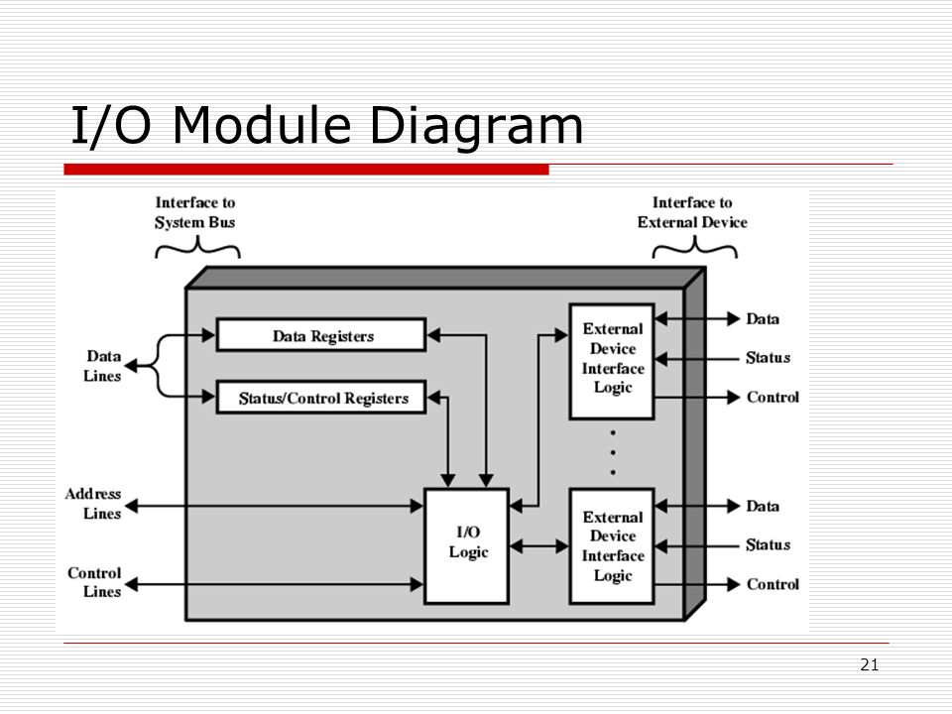

Slide 8
Memory Interfacing
When we are executing any instruction, we need the microprocessor to access the memory for reading instruction codes and the data stored in the memory. For this, both the memory and the microprocessor requires some signals to read from and write to registers.
The interfacing process includes some key factors to match with the memory requirements and microprocessor signals. The interfacing circuit therefore should be designed in such a way that it matches the memory signal requirements with the signals of the microprocessor.

Slide 9
IO Interfacing
There are various communication devices like the keyboard, mouse, printer, etc. So, we need to interface the keyboard and other devices with the microprocessor by using latches and buffers. This type of interfacing is known as I/O interfacing.

Slide 10
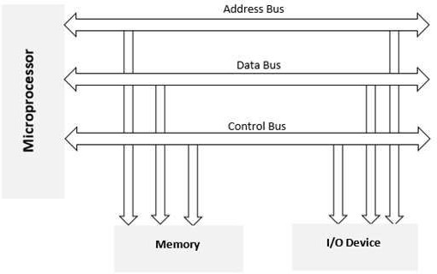
Block Diagram of Memory and I/O Interfacing

Slide 11
Comparison of Memory Mapped I/O and Peripheral I/O
Characteristics | Memory Mapped I/O | Peripheral I/O
Nature | I/O devices treated as memory. | I/O devices treated I/O.
Device Address | 16 bit | 8 bit
Control signals | MEMR/MEMW | IOR/IOW
Instructions | STA,LDA,STAX,LDAX, MOV M,R ADDM etc. | IN, OUT
Data transfer | Between any register and IO | Only between I/O and the accumulator
Access | I/O can be access by any memory instruction. | I/O can be access by only IN, OUT instruction.

Slide 12
Cont.
Characteristics | Memory Mapped I/O | Peripheral I/O
Maximum No. of I/Os possible | 64K is shared between I/Os and system memory | 256 input devices and 256 output devices
Execution speed | Slower due to more gates and circuits. | Faster due to less delay.
Hardware Requirements | More hardware is needed to decode 16 bit address | Less Hardware is required to decode 8 bit address
Other features | Arithmetic and logical operations can be directly performed with I/O data | Not Available

Slide 13
Interfacing with External Memory
An external memory interface is a bus protocol for communication from an integrated circuit, such as a microprocessor, to an external memory device located on a circuit board.
The memory is referred to as external because it is not contained within the internal circuitry of the integrated circuit and thus is externally located on the circuit board.
The external memory interface enables the processor to interface with third level caches, peripherals, and external memory.
Some common external memory interfaces include:
DDR
DDR2
GDDR

Slide 14
Data Transfer Schemes

Slide 15
Need for Data Transfer Scheme
A wide variety of IO devices having wide range of speed and other different characteristics are available
.
A slow responding IO device cannot transfer data when microprocessor issues instruction for it as it takes some time to get ready.
Transfers rates of peripherals is usually slower than the transfer rates of CPU.
Operating modes of peripheral are different from each other and each must be controlled so as not to disturb the operation of each other peripherals connected to CPU

Slide 16
Types of Data Transfer Scheme
Different types of data transfer techniques are available which can be broadly divided into two categories:-
MICROPROCESSOR CONTROLLED :- HERE data
transfer is controlled by microprocessor. Microprocessor is primarily responsible for data transfer whether from I/O to the CPU or to the memory or vice versa .
PERIPHERAL/DEVICE CONTROLLED:- Here data
transfer is controlled by I/O device . Data is transferred in between I/O device and memory without the intervention of CPU such a transfer increases rate of transfer and makes the system more efficient

Slide 17
Microprocessor Controlled DTS
Microprocessor based scheme is further divided into two parts:-
PROGRAMMED DATA TRANSFER SCHEME
INTERRUPT CONTROL DATA TRANSFER SCHEME

Slide 18
Programmed Data Transfer Scheme
Programmed data transfer scheme is controlled by the CPU . Data are transferred from an IO device to the CPU or to the memory through CPU or vice versa under the control of programs which are stored in memory. These programs are executed by the CPU when an I/O device is ready to transfer data.
The program data transfer schemes are employed when small amount of data are to be transferred.

Slide 19
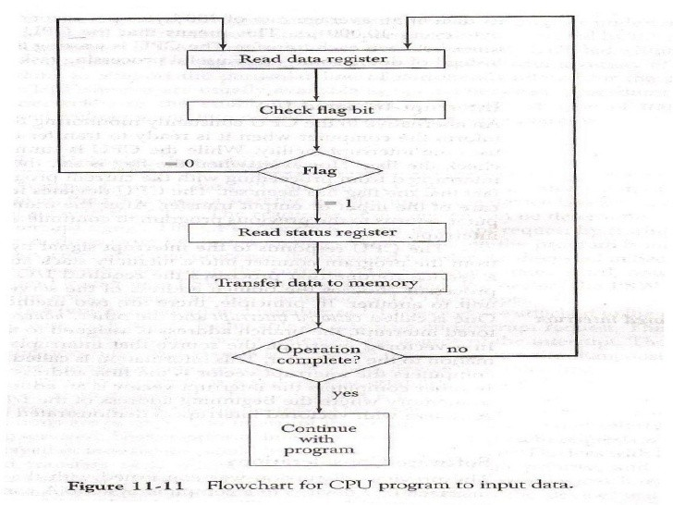

Slide 20
Here also synchronous and asynchronous mode of transfer is used.
Synchronous Data Transfer :-
Synchronous means ‘at the same time’. The device which sends data and the device which received data are synchronized with the same clock. When the CPU and I/O devices match in speed, Synchronous Data Transfer technique is employed.
The data transfer with IO devices is performed by executing IN and OUT instruction. The IN instruction is used to read data from an input device or input port.
The OUT instruction is used to sends data from CPU to the output device or output port. As the CPU and the IO devices match in speed, the I/O device is ready to transfer data when IN or OUT instruction is executed. The status of the I/O device, whether it is ready or not, is not examined before the data is transferred.

Slide 21
Asynchronous mode of transfer :-
Asynchronous means ‘at irregular intervals’. In this method data transfer is not based on predetermined timing pattern. This technique of data transfer is used when the speed of an I/O device does not match the speed of the microprocessor.
In this technique the status of the I/O device i.e. whether the device is ready or not, is checked by the microprocessor before the data are transferred. The microprocessor initiates the I/O device to get ready and then continuously checks the status of I/O device till the I/O device becomes ready to transfer data.
When I/O device becomes ready, the microprocessor executes instruction to transfer data.

Slide 22
This mode of data transfer is also called handshaking mode of data transfer because some signals are exchanged between microprocessor and I/O devices before the actual data transfer takes place. Such signals are called handshake signals.

Slide 23
Drawback of Programmed Data Transfer Scheme
The microprocessor is too busy.
The CPU is wasting time while checking the flag instead of doing some useful work.

Slide 24
Interrupt Driven Data Transfer
The problem with programmed I/O is that CPU has to wait along time for the I/O device to be ready for reception or transmission of data
.The CPU while waiting, must repeatedly interrogate the status of the I/O device . As a result the level of the performance of the entire system is severely degraded.
An alternative is interrupt driven IO data transfer.

Slide 25
Transfer Operation
In this scheme when the I/O device becomes ready to transfer data, it sends a high signal to the microprocessor through a special input line called an interrupt line. In other words it interrupts the normal processing sequence of the microprocessor.
On receiving interrupt the microprocessor completes the current instruction, saves the contents of the program counter on stack first and then attends the I/O devices. It take up a subroutine called ISS (Interrupt Service Subroutine). It execute ISS to transfer data from or to the I/O device. Different ISS are to be provided for different IO devices. After completing the data transfer the microprocessor returns back to the main program which it was executing before the interrupt occurred.

Slide 26
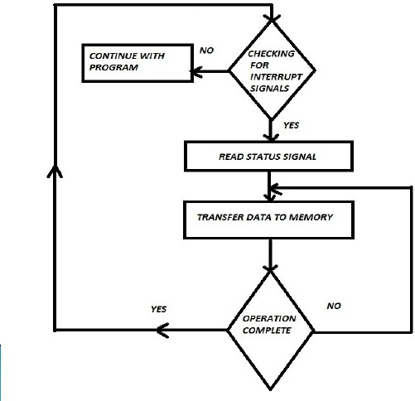

Slide 27
Drawback of Interrupt Driven Data Transfer
The normal operation of the microprocessor is interrupted.
It needs to continue monitoring for interrupt signals.

Slide 28
Device Control Data Transfer
The transfer of data between the mass storage device and a system memory is often limited by the speed of microprocessor. Removing the microprocessor during such a transfer and letting the peripheral manage the transfer to or from memory would improve the speed of transfer and hence will make the system more efficient. This transfer technique is called DMA Data Transfer.

Slide 29
During DMA transfer microprocessor is idle, so it has no longer control on the system buses. A DMA Controller takes over the buses and manage the transfer directly between the peripheral and the memory
It is fastest scheme then Programmed Data Transfer Scheme and the microprocessor regains the control of buses after data transfer

Slide 30
